Slide 1
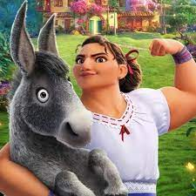
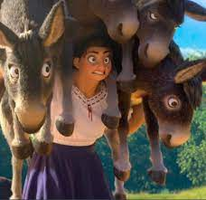
Social Emotional Development
Dealing with Pressure
Tuesday, July 5, 2022
Opening: Watch this video clip and prepare to discuss
Encanto- Surface Pressure
Discussion: What is Luisa describing in the song “Surface Pressure”? Have you ever had an experience that made you feel like you were under too much pressure? How did you handle it?

Slide 2
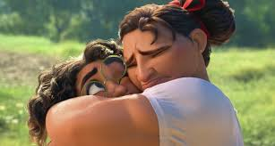
Social Emotional Development
What is Stress?
Wednesday, July 6, 2022
Opening: Watch this video clip and prepare to discuss
What is stress?
Discussion: What is stress? What are some causes of stress? What is one thing you can do to manage stress?
Activity: Balloon Breathing
Place both hands on top of your head. Begin to breathe in and out slowly. As you inhale, raise your arms above your head, like you are blowing up a balloon. When your lungs are full of air, your arms should look like a big, round balloon on top of your head. As you exhale, slowly bring your hands toward your head.

Slide 3
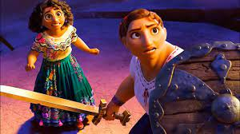
Social Emotional Development
What can I do to de-stress?
Thursday, July 7, 2022
Opening: Watch this video clip and prepare to discuss
Read Aloud: Stressed Ninja
Discussion: In this book, Ninja discussed some things that would cause her to get stressed such as moving, having a busy schedule, or joining a new sports team. What is something she did to turn her stress into calm?
Activity: Melting Exercise

Slide 4
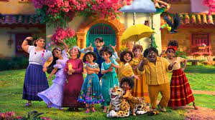
Social Emotional Development
Friday, July 8, 2022
Community Friday: Good Trouble, Necessary Trouble
Opening: Watch this shorty video and prepare to discuss.
Read Aloud: Speak Up!
Discussion: Sometimes we know things are not right but we may be afraid to speak up because we don’t want to cause trouble. This book gives us many ideas for when we should speak up for ourselves and others. Why do you think this is necessary?

