Slide 1
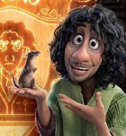
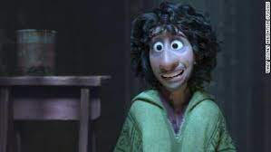
Social Emotional Development
What is inclusion?
Monday, July 11, 2022
Opening: Have you ever felt left out of an event or activity? How does it feel to not be included?
Discussion: Watch this video clip and think about how Bruno might have felt? What is inclusion and why does it matter?
Encanto- We Don’t Talk About Bruno

Slide 2
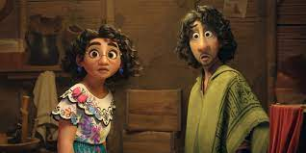
Social Emotional Development
What is diversity?
Tuesday, July 12, 2022
Opening: Watch this video clip and prepare to discuss.
Read Aloud: We're Different, We're the Same
Discussion: To be diverse means to be different. In what ways are you and your friends different? How are you different from your family members? Why do you think diversity is important?

Slide 3
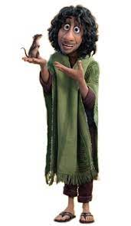
Social Emotional Development
What makes you unique?
Wednesday, July 13, 2022
Opening: Watch this video clip and prepare to discuss
Stand Out & Be Unique
Discussion: Every person is unique in their own way. What made the young girl in the video unique? How did it make her feel at first? How did her attitude change?
Activity: Share one thing about you that you feel is unique!

Slide 4
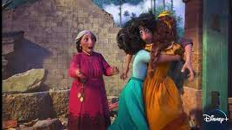
Social Emotional Development
Telling Your Own Story
Thursday, July 14, 2022
Opening: This week we talked about diversity, accepting others, and being proud of what makes us unique. Today, we will use what we have learned to tell our own stories.
Activity: Self-Portrait
Create a self portrait that shows us exactly who you are. Be sure to add vivid details that shows what makes you unique. Think of at least 5 words that you can use to describe yourself. Add those words to your drawing.

Slide 5
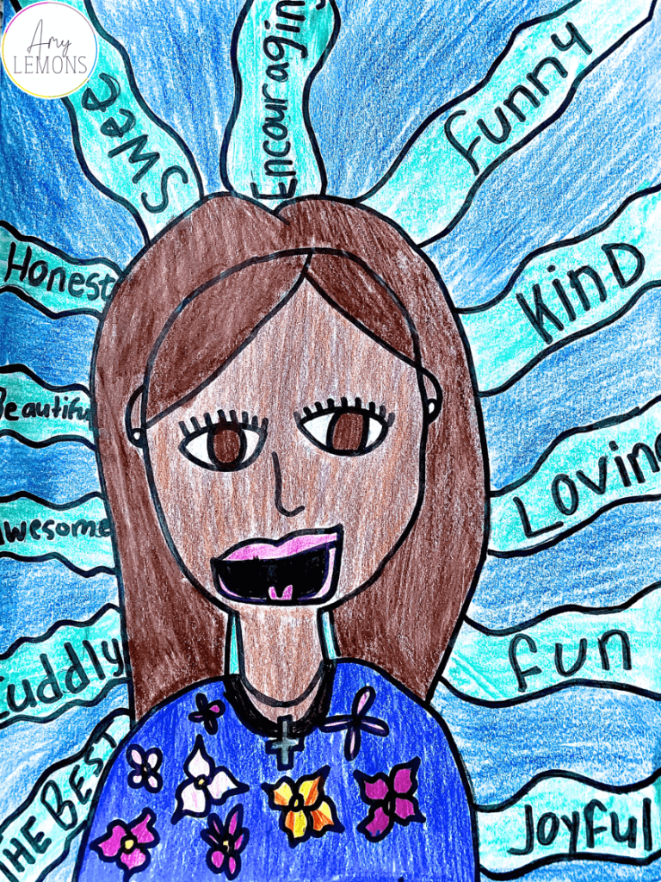
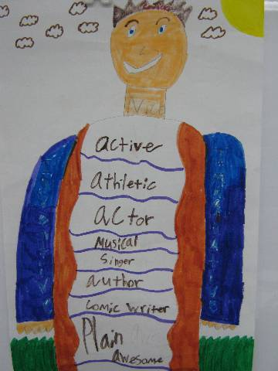

Slide 6
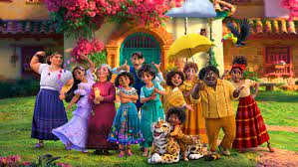
Social Emotional Development
Community Friday: What Makes a Community Diverse?
Friday, July 15, 2022
Opening: Watch this video clip and prepare to discuss
Encanto: All of You
Discussion: How does this song at the end of “Encanto” illustrate the importance of community?
Activity: Identify 1 person who you consider to be important members of your community. Think about what makes them unique and why you appreciate them. Write a note or draw a picture thanking them for being an important part of your community.

