Slide 1
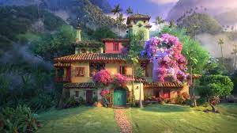
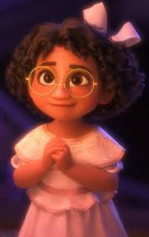
Social Emotional Development
EVERYONE is Good at Something
Monday, June 27, 2022
Opening: Let’s watch this video and discuss some ways to build our confidence and self-esteem.
Building Confidence
Discussion: Confidence is believing in yourself and your abilities. When you are confident, it means you recognize the things you are good at and are happy to try new things too! Good Self-Esteem means you accept yourself and feel positive about yourself just the way you are.
There were many great ideas in this video about how to build our confidence and self-esteem. Which one of these will you remember this week? Why?
Don’t compare yourself to others
Things take practice so don’t be hard on yourself
Turn down negative self talk
Set realistic goals
Keep trying and don’t give up
Embrace constructive criticism
Believe in yourself and celebrate your differences

Slide 2
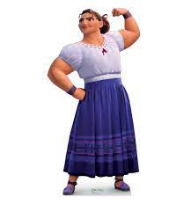
Social Emotional Development
How do we build ourselves up?
Tuesday, June 28, 2022
Opening: Yesterday we learned that confidence is like a muscle that we can work on to get stronger and stronger. Today we will work on building our confidence by highlighting some of our strengths. We will also think about one thing we want to get better at and come up with a plan to help us improve.
Activity: I Am Good At/I Want to Get Better At
Think of at least 3 things you are good at. Write or draw a picture to explain your skill.
Now, think of one thing you want to improve on. What are 3 small steps you can take to get better?

Slide 3
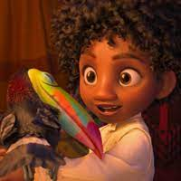
Social Emotional Development
We All Have Gifts
Wednesday, June 29, 2022
Opening: Watch this video clip and prepare to discuss
Encanto: Young Mirabel
Discussion: In this clip, we see that young Mirabel does not get a “gift” like the rest of her family members and this makes her feel like she is not special. However, we have been learning that we all have something good to share with the world, even if we don’t know what it is yet! Today, we will begin thinking more about our own gifts by first figuring out our values, or what things are important to us.
Activity: What things are most important to you? Why do you value these things?

Slide 4
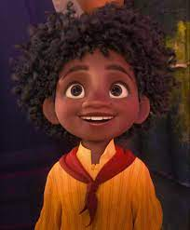
Social Emotional Development
We All Have Gifts Part 2
Thursday, June 30, 2022
Opening: Understanding our values, or what is important to us, can help us learn more about our own gifts and how we can make our communities better. Today we will continue learning about our values and how they help us understand our gifts.
Activity: Values-What is important to me?

Slide 5
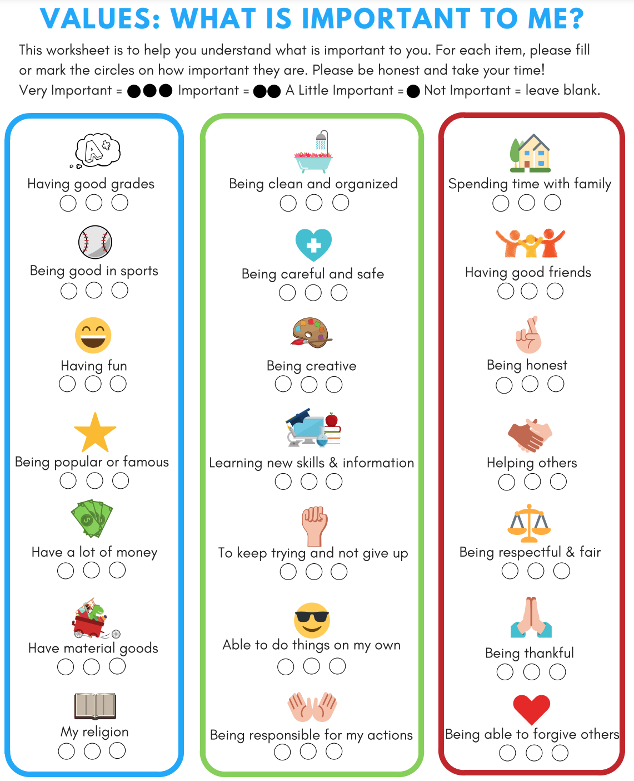
Notes:
Students can use a piece of paper and create three columns: Very Important, A Little Important, Not Important. Under each column they can list each of these values. They can also add values that are not listed.

Slide 6
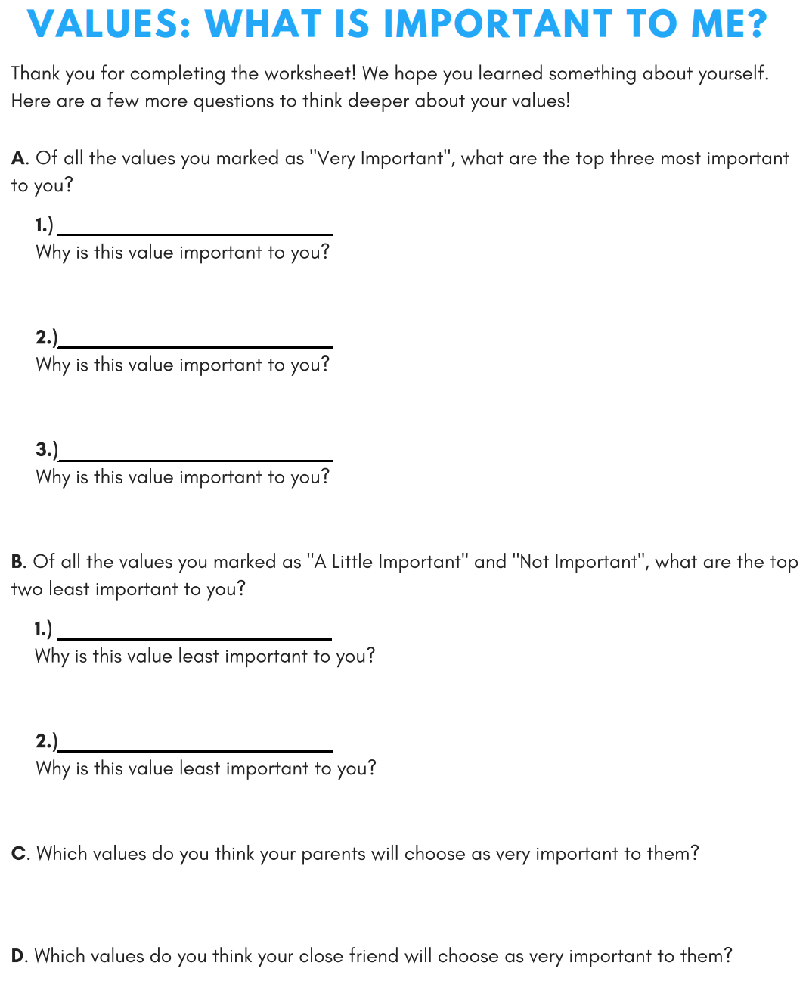
Notes:
Discussion

Slide 7
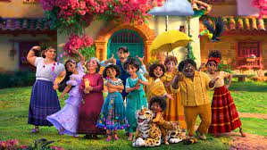
Social Emotional Development
Friday, July 1, 2022
Community Friday: What can you do for your community?
Opening: Watch this video clip and prepare to discuss John Lewis and how he used his gifts to help his community.
Facts About John Lewis
Discussion: This week we talked about how we all have gifts, and we just saw how John Lewis used some of his gifts to help his community. What are some ways you can use your gifts to help your community?
Notes:
Gifts could include courage, kindness, bravery, etc.

